Slide 1
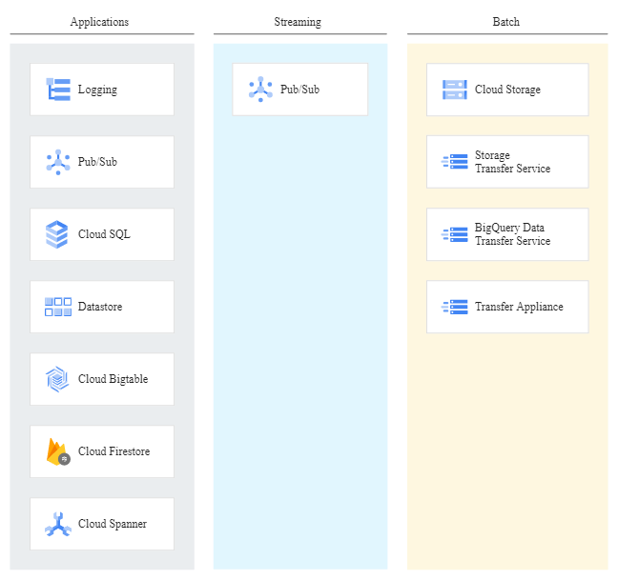
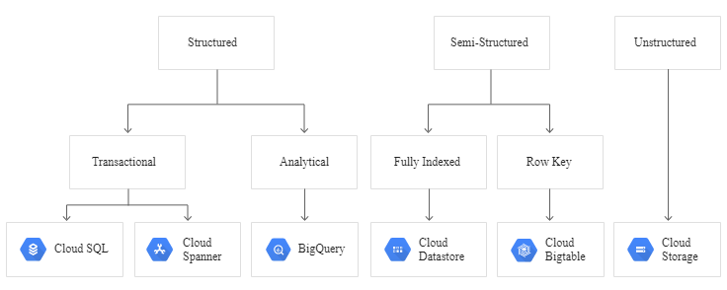
Towards to GCP

Slide 2
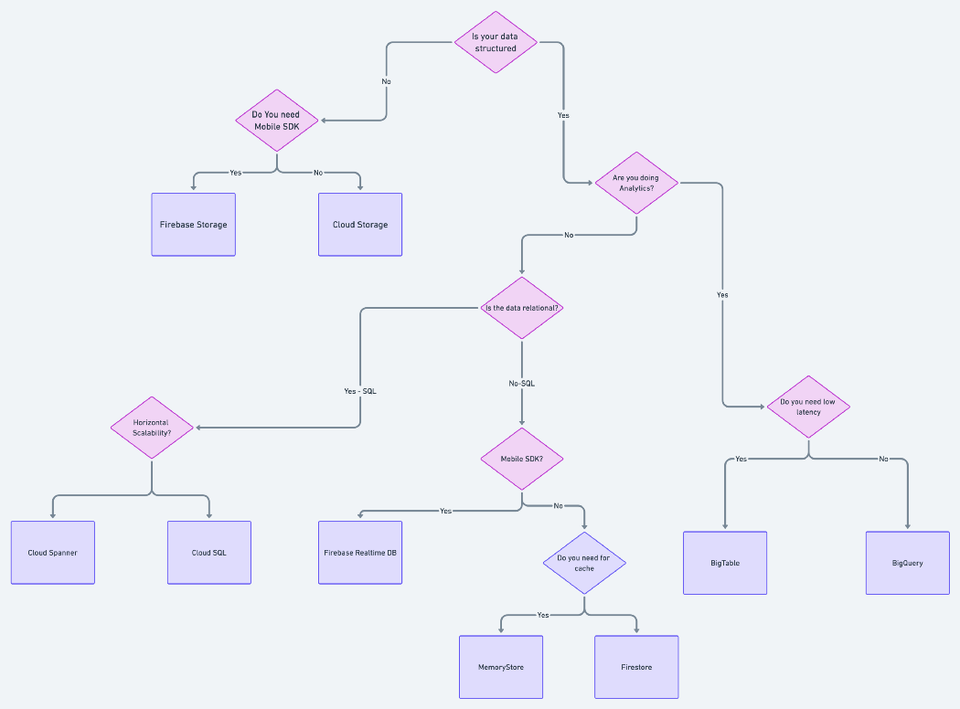
How to choose Database

Slide 3
GCP database Properties
Database | Description | When to use | UseCase
Cloud SQL Relational A relational GCP database service that is fully managed and compatible with MySQL, PostgreSQL and SQL Server, Cloud SQL includes features like automated backups, data replication, and disaster recovery to ensure high availability and flexibility. | Manage a database using Infrastructure as Code (IaC) Fully managed relational databases lowers maintenance costs Ensures increased serviceability with automated database provisioning, fair storage capacity, and database management Default size is 10TB, you can add 400GB RAM and 30 TB storage for scalability Easy Integration with Google Cloud services and other applications One click replication of your instance to other region Automatic backups, achieve application compatibility and external migration of on-premises MYSQL database Ability to handle complex queries and multiple transactions simultaneously | From ‘lift and shift’ of on-premise SQL databases to the cloud to handling large-scale SQL data analytics to supporting CMS data storage and scalability and deployment of micro services, Cloud SQL has many uses and is a better option when you need relational database capabilities but don’t need storage capacity over 10TB. Cloud SQL recommended for E-commerce, Content Management System (CMS) and businesses with huge data. Your RDBMS needs a storage capacity of 10TB. | Lift and shift of on-premise SQL databases to the cloud Large-scale SQL data analytics Supporting content management system (CMS) data storage and scalability Managing databases using Infrastructure as Code (IaC) Development and deployment of containerized applications and microservices
Cloud Memorystore Designed to be secure, highly available, and scalable, Cloud Memorystore is a fully managed, in-memory Google Cloud data store that enables you to create application caches with sub-millisecond latency for data access. | Automates complex tasks for building applications at a high pace Fully compatible with Redis and Memcached Supports large clusters of 5TB Enables you to build application caches that provide sub-millisecond latency Low latency assists high speed data access and data transfer Redis instances are replicated in two zones for 99.99% availability Automated provisioning and replication Cloud monitoring and integration with OpenCensus for better insights Easy migration as no change in code required to switch applications | If you are using key-value datasets and your main focus is transaction latency. Cloud Memorystore is a considerable option to lift and shift migration of apps on GCP, for machine learning applications, and Real-time analytics. Best for high value data and for database consistency but it cannot handle voluminous data | Lift and shift migration of applications Machine learning applications Real-time analytics Low latency data caching and retrieval
Cloud Firestore NoSQL A fully managed, serverless NoSQL GCP database designed for the development of serverless apps, Cloud Firestore can be used to store, sync, and query data for web, mobile, and IoT applications. With critical features like offline support, live synchronization, and built-in security, you can even integrate Firestore with Firebase, GCP’s mobile development platform, for easier app creation. | Cloud Firestore use cases include mobile and web applications with both online and offline capabilities, multi-user, collaborative applications, real-time analytics, social media applications, and gaming forums and leaderboards. | When your focus lies on app development and you need live synchronization and offline support. Cloud Firestore is the recommended option of GCP if your focus is on app development and require offline support for marketing, social media, IoT and mobile applications. | Mobile and web applications with both online and offline capabilities Multi-user, collaborative applications Real-time analytics Social media applications Gaming forums and leaderboards
Cloud Spanner Relational Another fully managed, relational Google Cloud database service, Cloud Spanner differs from Cloud SQL by focusing on combining the benefits of relational structure and non-relational scalability. It provides consistency across rows and high-performance operations and includes features like built-in security, automatic replication, and multi-language support. | High reliability with zero downtime Gain from consistent performance across regions and continents No restriction of minimum and maximum size Efficient handling of replicas and automatic sharding of data on request load Easy deployment irrespective of database size Storage capacity of Petabytes ensures load handling Change schema without affecting the traffic Tested for 99.99% availability of database Backup and restoration available on demand Capable to store billions of data on daily basis | Cloud Spanner should be your go-to option if you plan on using large amounts of data (more than 10TB) and need transactional consistency. It is also a perfect choice if you wish to use sharding for higher throughput and accessibility. Cloud Spanner is built for database scalability and transactional consistency. Go for it if your data is likely to cross 10TB in due course. It is useful for Supply Chain Management and Financial Trading and Analysis. It is highly recommended for infrastructure monitoring and structured data. | Supply chain management and manufacturing Financial trading, analysis, and prediction Logistics and transportation
Notes:
How to choose right cloud database provider - Open Source For You (opensourceforu.com)
Choosing the right Google Cloud Platform (GCP)Database - (anarsolutions.com)

Slide 4
GCP database Properties
Database | Description | When to use | UseCase
Cloud Spanner Relational Another fully managed, relational Google Cloud database service, Cloud Spanner differs from Cloud SQL by focusing on combining the benefits of relational structure and non-relational scalability. It provides consistency across rows and high-performance operations and includes features like built-in security, automatic replication, and multi-language support. | High reliability with zero downtime Gain from consistent performance across regions and continents No restriction of minimum and maximum size Efficient handling of replicas and automatic sharding of data on request load Easy deployment irrespective of database size Storage capacity of Petabytes ensures load handling Change schema without affecting the traffic Tested for 99.99% availability of database Backup and restoration available on demand Capable to store billions of data on daily basis | Cloud Spanner should be your go-to option if you plan on using large amounts of data (more than 10TB) and need transactional consistency. It is also a perfect choice if you wish to use sharding for higher throughput and accessibility. Cloud Spanner is built for database scalability and transactional consistency. Go for it if your data is likely to cross 10TB in due course. It is useful for Supply Chain Management and Financial Trading and Analysis. It is highly recommended for infrastructure monitoring and structured data. | Supply chain management and manufacturing Financial trading, analysis, and prediction Logistics and transportation
Cloud Bigtable NoSQL It is a fully managed NoSQL Google Cloud database service that is designed for large operational and analytics workloads. Cloud Bigtable includes features for high availability and zero-downtime configuration changes. You can practically integrate it with a variety of tools, including Apache tools and Google Cloud services. Cloud Bigtable use cases cover financial analysis and prediction, IoT data ingestion, processing, and analytics, and hyper-personalised marketing applications. | No SQL database High availability of 99.99% and zero downtime even during reconfiguration Consistent sub-10ms latency can handle millions of requests every second Seamless scaling with dynamic support for hundreds of nodes Increase the Bigtable cluster size without any downtime Flexible automated replication increases availability and isolation of workloads for live apps Data repair and synchronizing the updates in data requires no manual intervention Easy connect with other Google Cloud services Designed to store the ML applications | Cloud Bigtable is a good option if you are using large amounts of single key data and is preferable for low-latency, high throughput workloads. Cloud BigTable is a good option for large amounts of data and analytics workloads and DevOps monitoring. | Financial analysis and prediction Internet of things (IoT) data ingestion, processing, and analytics Marketing applications, including hyper personalization
BigQuery DataWarehouse With BigQuery you can perform data analyses via SQL and query stream-data. Since BigQuery is a serverless data warehouse that’s fully managed, its built-in Data Transfer Service helps you migrate data from on-premises resources, including Teradata. It incorporates features for machine learning, business intelligence, and geospatial analysis that are provided through BigQuery ML, BI Engine, and GIS. | Storage 10TB free per month 1TB of query data processing free every month A serverless service enables processing of data automatically for multiple machines working simultaneously Built-in data transfer service for data migration from on-premises to cloud Can process data stored in other GCP products Store data in a columnar database for faster read and response rate Automatic encryption of data when at rest on in transit | Use cases for BigQuery involve process analytics and optimization, big data processing and analytics, data warehouse modernisation, machine learning-based behavioural analytics and predictions. BigQuery has a storage capacity of 10 TB and this GCP is suitable for data warehouse modernization and machine learning analytics and predictions. . | Process analytics and optimization Big data processing and analytics Machine learning-based behavioral analytics and predictions Data warehouse modernization
Firebase Realtime Database NoSQL This is a NoSQL Google Cloud database that is a part of the Firebase platform. It allows you to store and sync data in real-time and includes caching capabilities for offline use. It also enables you to implement declarative authentication, matching users by identity or pattern. It includes mobile and web software development kits for easier app development. | No SQL Google Cloud database that enables storage and data sync in real-time. Easy collaboration across devices for speedy and accurate access of data from web or mobile apps Realtime Database software development kits (SDKs) for faster app development Increase app engagement cloud messaging and other cloud functions | Use cases for Firebase Realtime Database involve development of apps that work across devices, advertisement optimisation and personalisation, and third-party payment processing. Firebase Realtime Database is useful for applications on GCP that need high security and authentication. It is best for third party payment processing, and Ads optimization and personalization | Development of apps that work across devices Ad optimization and personalization Third-party payment processing Integration of machine learning
Notes:
How to choose right cloud database provider - Open Source For You (opensourceforu.com)
Choosing the right Google Cloud Platform (GCP)Database - (anarsolutions.com)

Slide 5
A data fabric is a single environment consisting of a unified architecture, and services or technologies running on that architecture, that helps organizations manage their data.
Design Principle – Control->Choice->Integration->Access->Consistency
The ultimate goal of data fabric is to maximize the value of your data and accelerate digital transformation
Control. Securely retain control and governance of data regardless of its location: on premises, near the cloud, or in the cloud. •
Choice. Choose cloud, application ecosystem, delivery methods, storage systems, and deployment models, with freedom to change. •
Integration. Enable the components in every layer of the architectural stack to operate as one while extracting the full value of each component. •
Access. Easily get data to where applications need it, when they need it, in a way they can use it. •
Consistency. Manage data across multiple environments using common tools and processes, regardless of where it resides.
Data Ingestion
Data Governance
Data Access
Data Discovery/Catalog
Processing and Persistence
Orchestration
Notes:
Data Fabric Architecture (High Level) - Version 1.0 (agileea.com)

Slide 6
Data Fabric provides
sets of integrated services for the acquisition, ingestion and enrichment of data provided by both internal and external data suppliers.
It is the quintessential source of data that drives Equifax’s current and future product offerings.
As Equifax moves migrating customers and roll-out products onto the Data Fabric ecosystem,
it is critical that we obtain a level of operational maturity that can efficiently maintain day to day operations of the data moving through the pipeline, from acquisition through delivery.
Since the Data Fabric is a global service and supports many business units and products,
it is critical that the daily operations can support all of the data ingested and delivered, irrespective of the products that it enables.
EPAM has been asked to provide an estimate for implementing software and processes to help define and implement a Data Operations Center. A portal-based concept that will develop and deliver a baseline framework that can be easily expanded over time to support operational capabilities as need expands.
Deliver a platform and framework to monitor and measure timeliness and data quality through the data lifecycle, providing actionable insights ensuring end to end SLAs are met or exceeded

